Slide 1

The Innovation Lab
Summer Internship 2022
Mentor-Intern Meeting 4
VAAYUBHOOMI
Mentors: Shayak Bhadraray Harshith Kumar MB
T Vijay Prashant
Interns: Pramuk MP
Samuel Thomas
Sriram Radhakrishna

Slide 2
Problem Statement
Networked robots for waste management & associated reconnaissance
Specific use case - Trash collection over open public spaces
UAV patrols a specific hexagonal path and uses cameras and Lidar to detect trash on the ground
It will store the location of the trash and send it to the UGV that will then use path planning to navigate to the garbage and pick it up
<Project Name>

Slide 3
Proposed Approach
We intend to execute this project in two phases : Phase 1 is a simulation of the UAV and Phase 2 is an implementation of an autonomous system with the UGV.
Phase 1 UAV - Patrol bot that works in a specified area
Detects specific targets (i.e.; piles or individual pieces of waste) while on predetermined patrol path.
Records the pose of the drone at the location of target detection and saves it’s ground coordinate projection.
After saving the locations, they are filtered down to specific points by taking the centroid(s) of the dataset of coordinates (we might cluster the points based on a threshold distance)
A simulation of the same will be made using the hector quadrotor package.
Phase 2 UGV - Ground vehicle
Cameras and sensors integrated for autonomous capabilities.
The UGV will navigate to the previously mentioned centroid locations, track the targets using a static lidar, clean up each target location using manipulators.
Apply inverse kinematics and modify urdf files of the manipulator of the turtlebot3 to suit the operation.
SLAM, path planning and obstacle avoidance.
<Project Name>

Slide 4
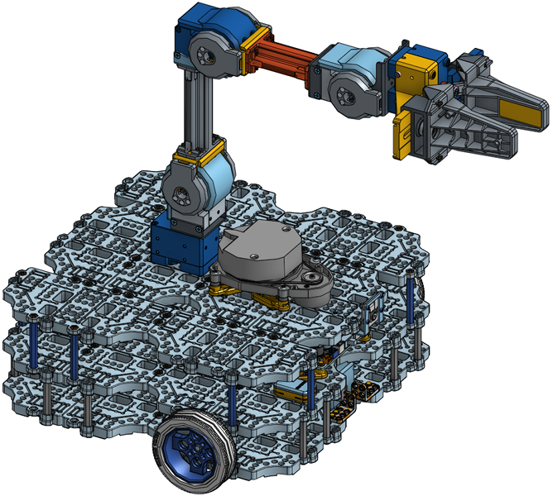
TURTLEBOT WITH MANIPULATOR

Slide 5
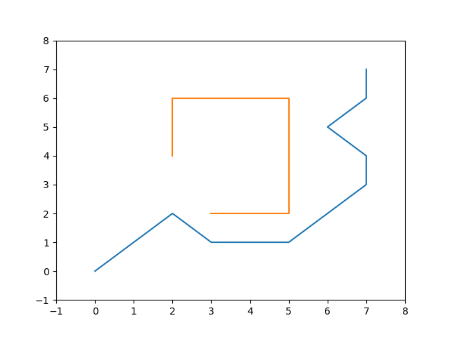
We’ve divided the repository into three branches since the last MIM - obstacle avoidance (Pramuk), path planning (Samuel) & vision (Sriram).
In the obstacle avoidance branch:
Applied PID controller on turtlebot 3.
Accuracy is around 80%. Improving the code to suit all kinds of environment.
In the path planning branch:
Implemented PID controller to move to a goal
A* star algorithm was implemented in python using matlab plot
Diagonal distance was used for the h heuristic
Implementation to now be converted to turtlebot 3 environment.
Progress
<Project Name>

Slide 6
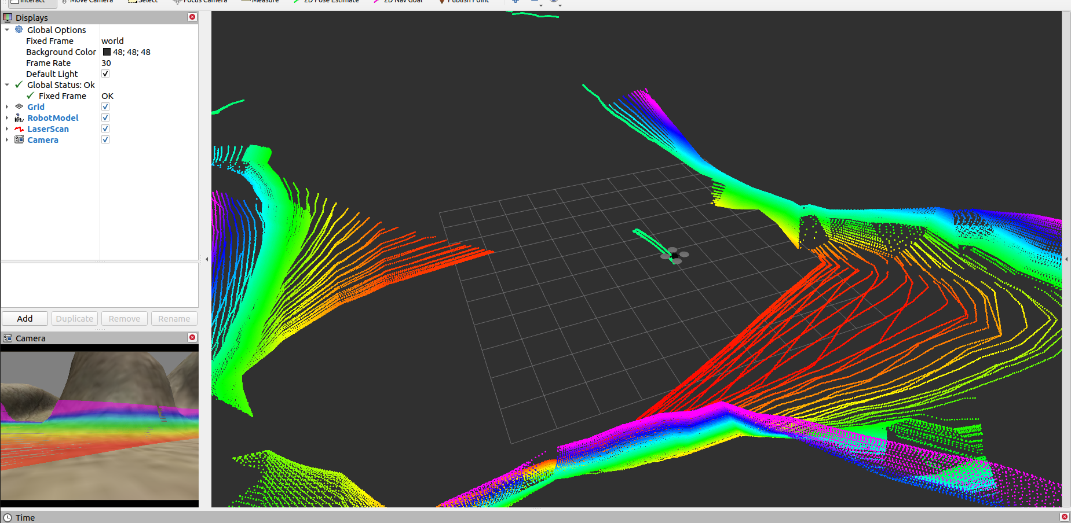
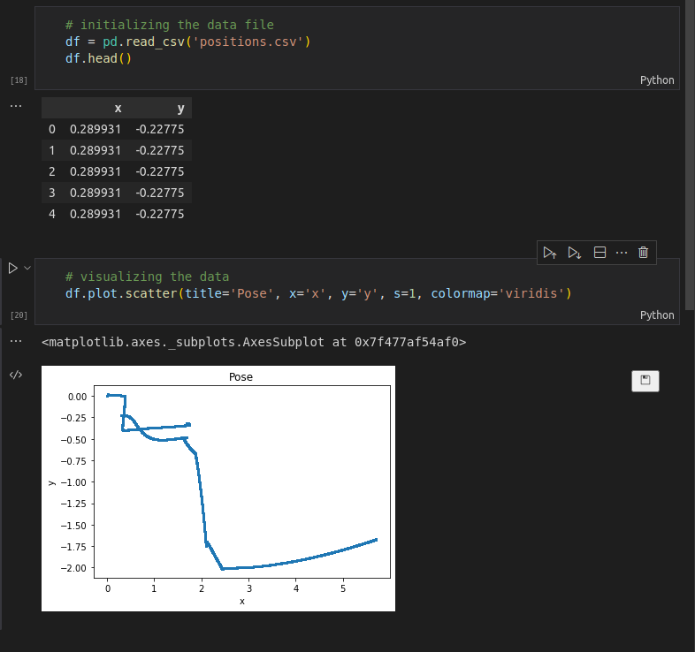
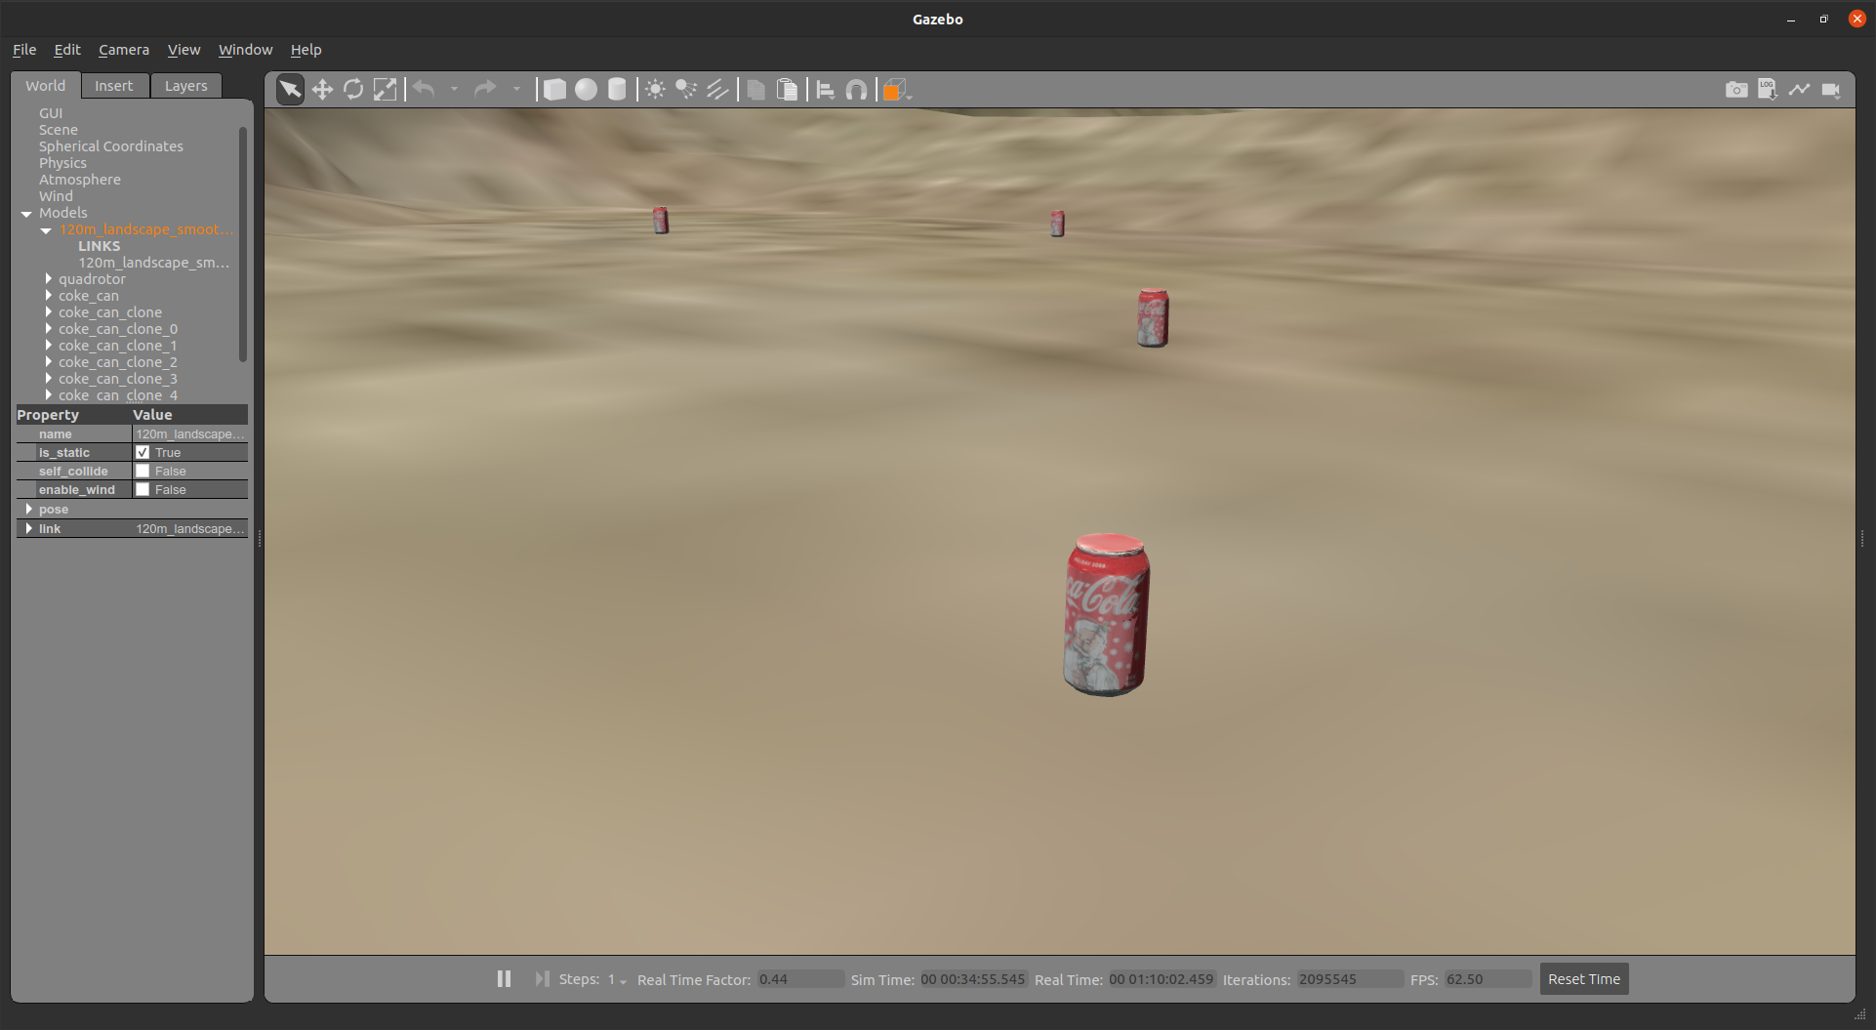
In the vision branch …
CVBridge was set up and tested successfully with the Hector quadrotor as well as turtlebot 3 simulations.
Nodes were written to take the quadrotor through a pre-planned path through a valley scattered with coke cans.
A basic vision algorithm was written to detect the cans using colour filtering, dilations and contour detection.
The same algorithm was made to record the pose of the drone and append to a CSV file. These pose locations were visualized using pandas as shown alongside.
Cue the demo video for the same.
Progress (2)
<Project Name>

Slide 7
Decision to be made between using a ground station or do onboard processing.
Discretization of waypoints along the path of the UAV to mark locations
Location of the UAV when trash detected to be stored in a csv file, that is then incorporated into UGV path planning
Computer Vision to be able to detect trash necessary
Integration of path planning, obstacle avoidance and vision
Use inverse kinematics and end effectors to pick up trash
Garbage to be dropped off at a designated point
Roadmap:
<Project Name>

Slide 8
Plan for the next 2 weeks
Vision:
We’ll be substituting the current algorithm for a neural net trained to detect trash piles. We’ve narrowed down some datasets for the same already.
Write an algorithm to cluster the dataset of points as mentioned before to get workable target locations.
Obstacle Avoidance:
Improve performance and implement it on hector quadrotor as well as turtlebot3
Combine path planning and obstacle avoidance.
Path planning:
UAV spiral path to be created and integrated with obstacle avoidance
UGV path plan to be designed to move to locations given by csv file from vision while avoiding obstacles along the way
<Project Name>

Slide 9
Thank You

